Slide 1

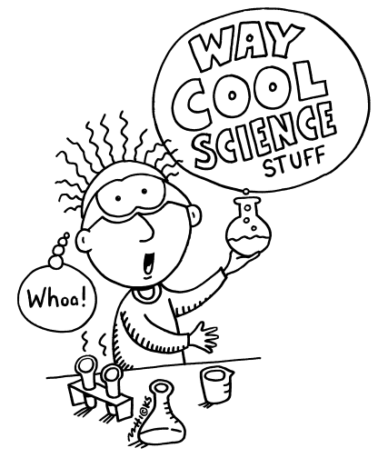

BASIC CONCEPTS IN CHEMISTRY
Dr. M. Srinivas
M.Pharm,PhD
Professor & HOD
Department of Pharmaceutical Chemistry

Slide 2
Chemistry?

Slide 3
Chem + i +stry
Chemicals
in
History
History in Chemicals

Slide 4
History
History
Birth
Synthesis
Death
Degradation
Reaction

Slide 5
Reaction in Chemicals = Chemistry
Study of Chemical Reactions
Chemical reactions in Biological system
Bio-Chemistry

Slide 6
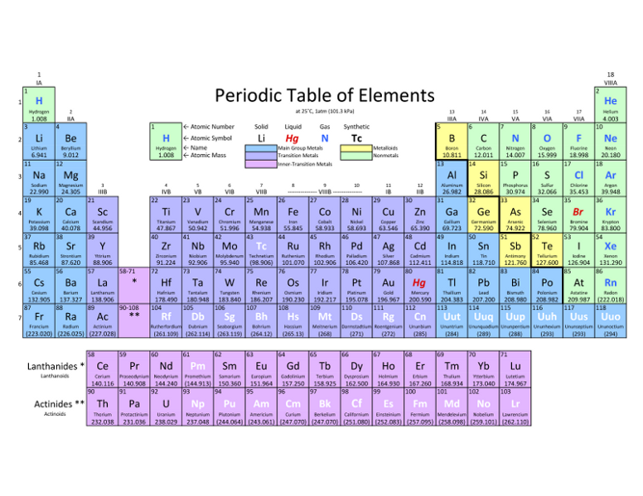
The Basics: Periodic
WATCH THIS!
Amazing Chemical Reactions
WATCH THIS! Daniel Radcliff (Harry Potter) sings “The Element Song”!

Slide 7
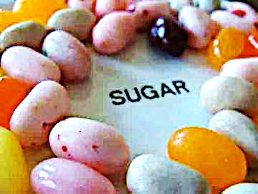
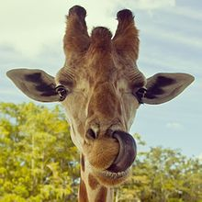
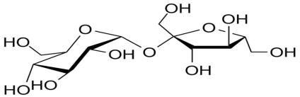
Organic Molecules
Carbohydrates
• “carbon” - hydrates”
(Hydrates is a substance that contains water)
• One carbon molecule to one water molecule (CH₂0)n.
• saccharide is a synonym for carbohydrate.
• The prefixes on the word “saccharide” relates to the size of the molecule (mono-, di-, tri- poly-).
BOOGERS!
You probably know that jelly beans are full of refined sugars…carbs. You may not know that boogers contain carbs as well. Boogers are dried-up mucus and dirty nose debris. Mucus is made mostly out of sugars and protein.
Notes:
Saccharide

Slide 8
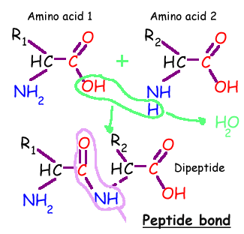
Organic Molecules - Proteins
Proteins are macromolecules, polymers composed of monomers called…
Amino acids contain a:
1. base amino group ( -NH₂)
2. acidic carboxyl group ( -COOH)
3. hydrogen atom
…all attached to same carbon atom (the α –carbon…alpha carbon).
4. Fourth bond attaches α-carbon to a side group (--R) that varies among different amino acids.
Essential amino acids: Cannot be synthesized by the body. They must be ingested in the diet.
Arginine * Histidine * Methionine* Threonine * Valine * Isoleucine * Lysine * Phenylalanine *
Tryptophan * Leucine

Slide 9
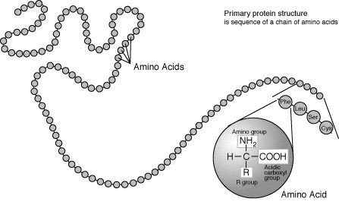
Organic Molecules – Proteins
Peptide Bonds
Link amino acids together in chains, like the beads on a necklace.
A dipeptide is 2 amino acids linked together.
A polypeptide, more than two.

Slide 10
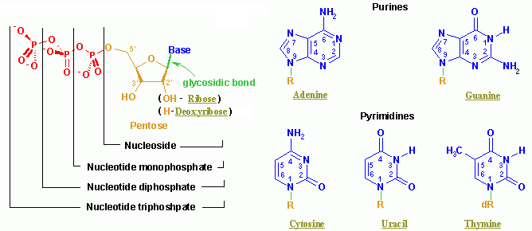
Organic Molecules – Nucleic Acids
Nucleic acids (both RNA and DNA) are macromolecules; polymers made up of monomers called nucleotides.
Nucleic acids deoxyribonucleic acid (DNA) and ribonucleic acid (RNA) = genetic material of cells.
Names derived from type of sugar contained within molecules = ribose
Nucleotides
Each monomer of nucleic acid is a nucleotide and consists of 3 portions:
- a sugar
- one or more phosphate
- one of five cyclic nitrogenous bases
+adenine, guanine (double-ringed purines)
+ cytosine, thiamine or uracil (single-ringed pyrimidines)

Slide 11
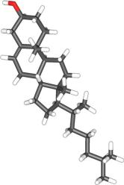
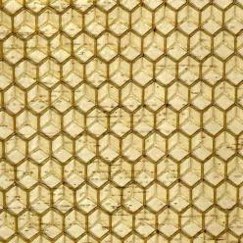
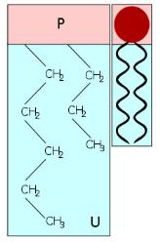
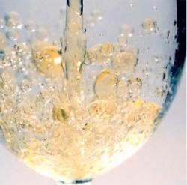
Organic Molecules – Lipids
(Fats, Phospholipids, Waxes & Steroids)
Hydrophobic macromolecules…insoluble in water.
Not attracted to water because …
non-polar covalent bonds linking carbon & hydrogen aren’t attracted to the polar bonds of water.

Slide 12
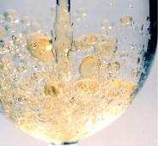
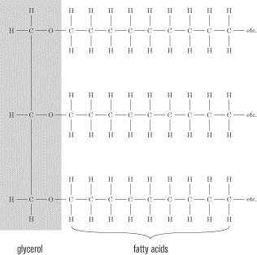
Organic Molecules – Lipids
(Fats, Phospholipids, Waxes & Steroids)
Fats
Fats and oils are made from two kinds of molecules:
• glycerol
(a type of alcohol)
• fatty acids
(triglycerides)

Slide 13
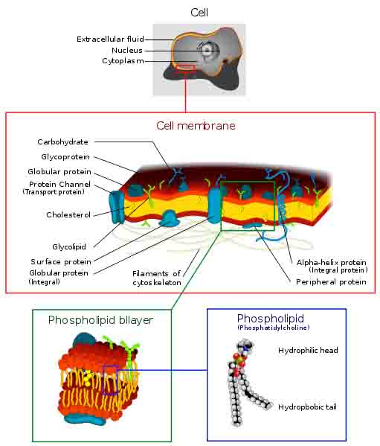
Organic Molecules – Lipids
(Fats, Phospholipids, Waxes & Steroids)
Phospholipids
• Phospholipids are a major component of all cell membranes.
Most phospholipids contain a diglyceride as the tail, and a phosphate group for head.
Hydrocarbon tails are hydrophobic, but phosphate heads are hydrophilic.
• So phospholipids are soluble in both water and oil.
• Tails from both layers facing inward and the heads facing outward = phospholipid bilayer.
Image: Cell Membrane, Wiki;

Slide 14
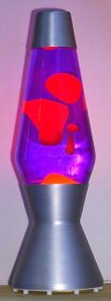

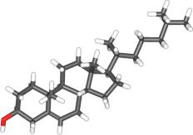
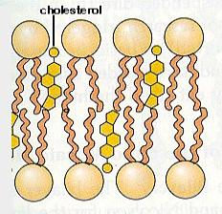
Organic Molecules – Lipids
(Fats, Phospholipids, Waxes & Steroids)
Waxes
• Do not have a hydrophilic head: so completely water insoluble.
Steroids
• The central core of a cholesterol molecule (4 fused rings) is shared by all steroids.
• Cholesterol is precursor to our sex hormones and Vitamin D.
• Our cell membranes contain cholesterol (in between the phospholipids) to help keep membrane “fluid” even when exposed to cooler temperatures.

